Slide 1
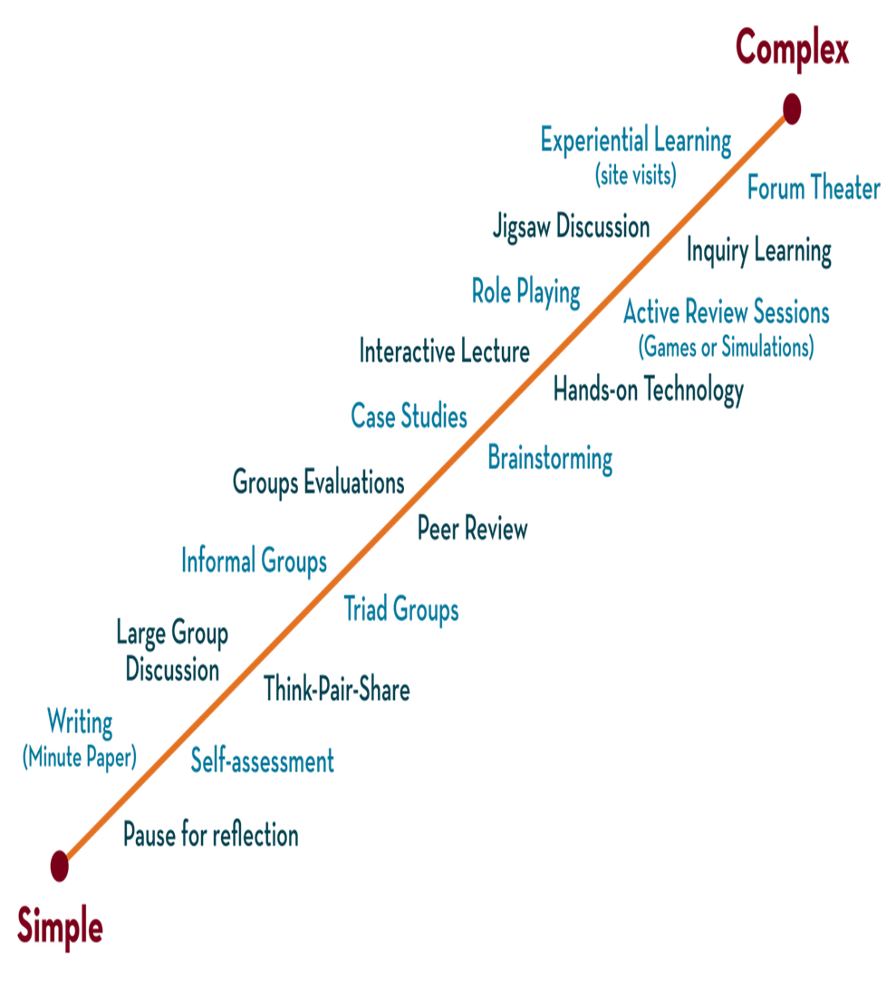

Department of CSE
DESIGN AND ANALYSIS OF ALGORITHMS
24CS2203
Topic:
Tower of Hanoi
Session - 7

Slide 2





AIM OF THE SESSION
To familiarize students with the concept of Dynamic Programming.
INSTRUCTIONAL OBJECTIVES
This Session is designed to:
Demonstrate :- Dynamic programming and its elements.
Describe :- Steps that the dynamic programming follows.
LEARNING OUTCOMES
At the end of this session, you should be able to:
Define :- Dynamic programming and its elements.
Describe :- Principles of optimality
Summarize:- top-down and bottom-up approaches of dynamic programming.

Slide 3
Tower of Hanoi
The Tower of Hanoi is a classic recursive problem where the goal is to move n disks from one rod (source) to another rod (destination) using a third rod (auxiliary) while following these rules:
Only one disk can be moved at a time.
A disk can only be placed on top of a larger or empty rod.
The objective is to move all disks with the minimum number of moves.

Slide 4
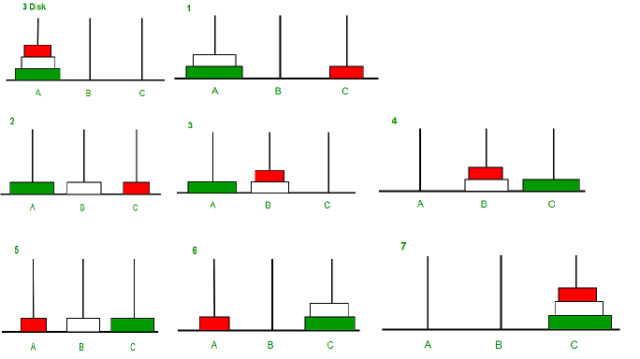

Slide 5
Algorithm
The recursive solution for the Tower of Hanoi problem can be expressed as:
Move the top n−1 disks from the source rod to the auxiliary rod.
Move the n-th (largest) disk from the source rod to the destination rod.
Move the n−1 disks from the auxiliary rod to the destination rod.

Slide 6
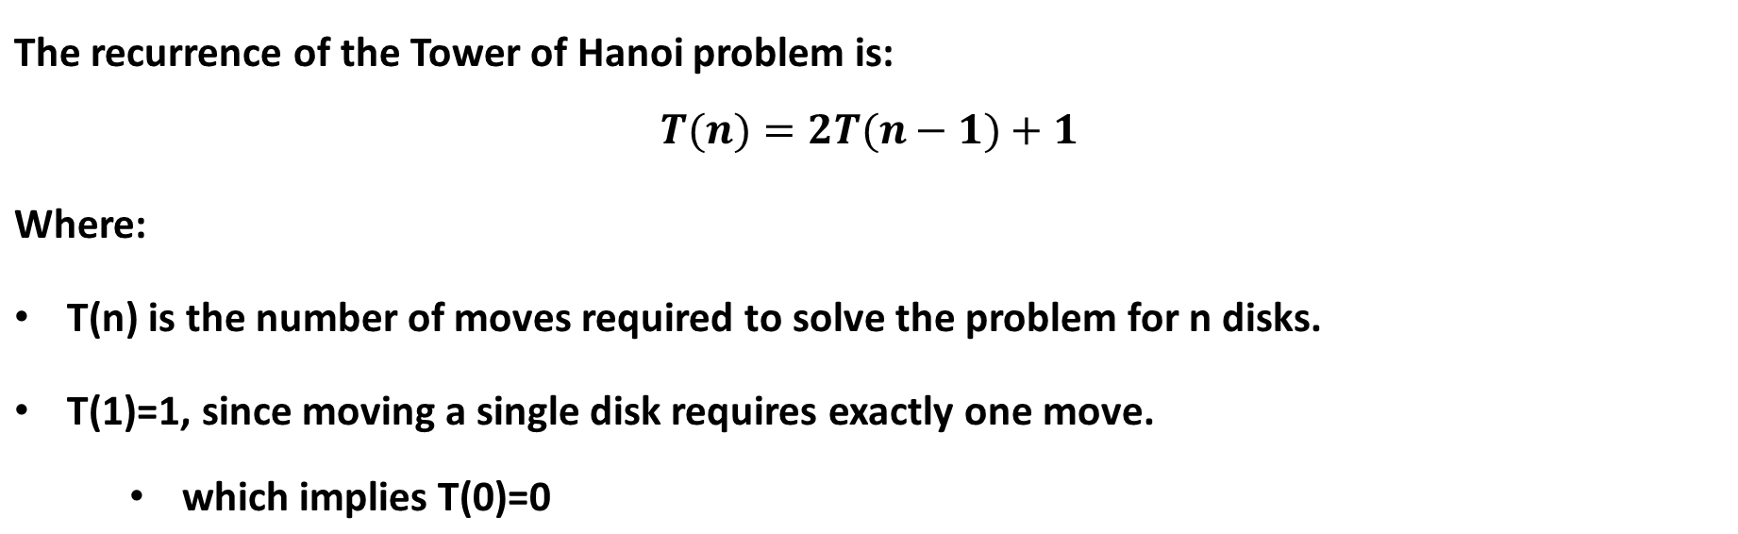
Recurrence Relation

Slide 7
Solve RR

Slide 8
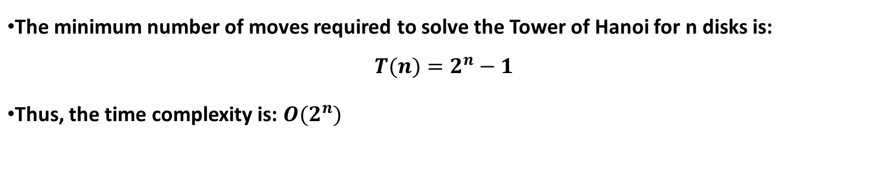
Time complexity

Slide 9
REFERENCES FOR FURTHER LEARNING OF THE SESSION
Text Books :
1. Ellis Horowitz, Sartaj Sahni and Sanguthevar Rajasekaran, “Fundamentals of ComputerAlgorithms”, 2nd Edition, University Press, 2008.
2. Cormen, Leizerson &Rivest, “Introduction toalgorithms”, 3rd Edition, Prentice-Hall, 2002.
3. Jon Kleinberg and Eva Tardos, “Algorithm Design”,Pearson Education, 2006.
Reference Books :
1. Robert Sedgewick and Kevin wayne , “Algorithms”, 4th edition, Addison WesleyProf.,(2011).
2. Anny Levitin, “Introduction to Design and Analysis of Algorithms”, 2rd Edition, PersonEducation Press. (2007).
3. Michael T.Goodrich and Roberto Tamassia, Algorithm Design: Foundations,Analysis and Internet Examples, Second Edition, Wiley-India, (2006).
4. Steven S. Skiena, “The AlgorithmDesign Manual”, Second Edition, Springer, (2008)
MOOCS :
1. https://www.coursera.org/specializations/algorithms?= 2.https://www.coursera.org/learn/dynamic-programming-greedy-algorithms#modules

Slide 10
THANK YOU

